Slide 1
ReDesign the Rubik’s Cube
Based on your learning so far, discuss what barriers a traditional Rubik's cube might have.
Then consider possible solutions we could include in the design to provide access for those barriers
Notes:
Now that we have had some time to explore UDL, refer back to the BARRIER of each individual in your group. How could we change the ‘design’ the rubric so that participants could still accomplish the goal?
Goal = Goal
Rubic’s = lesson
Barriers = Barriers
Struggles with Fine Motor Skills - GREEN
Color Blind - LIME GREEN
Blind - PURPLE
EL Learner Level 1 (know your colors but dont adjectives that describe direction) - PINK
Knows how to solve a 3x3 rubic’s cube - BLUE
Math Facts - YELLOW
Not reading at grade level - ORANGE

Slide 2
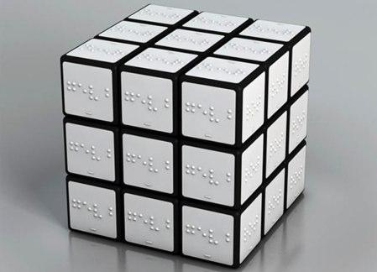
Braille Rubik's cube
Braille version of Rubik’s cube

Slide 3
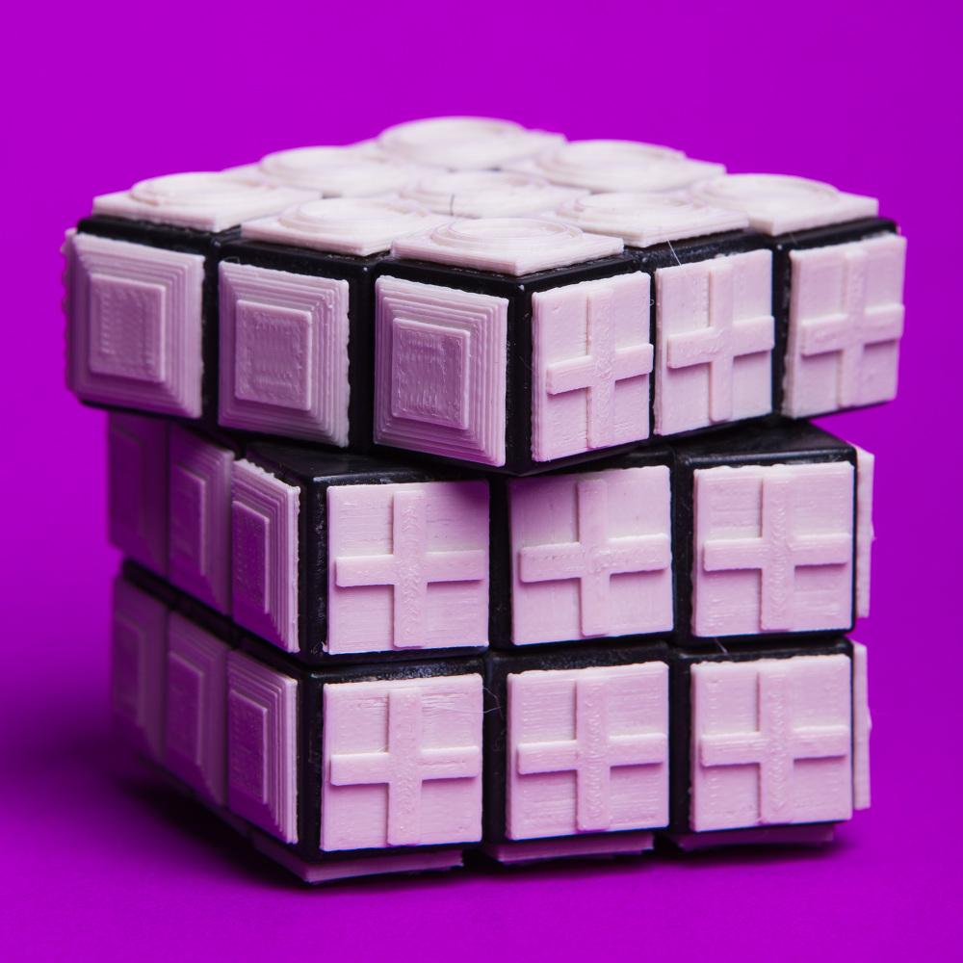
Color Blind Rubik's cube
Color blind version of Rubik’s cube using raised shapes on squares.

Slide 4
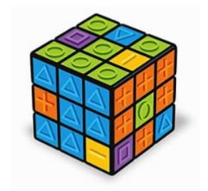
Universal Design Rubik’s cube
Universal design of Rubik’s cube. Uses raised shapes and easy colors.

Slide 5
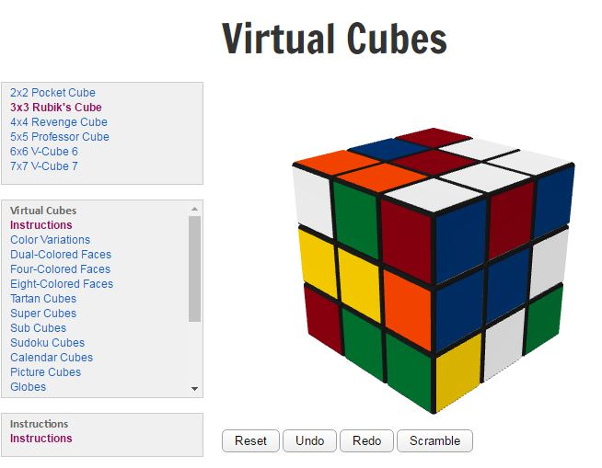
Virtual Cubes
Virtual Cube examples
2x2 Pocket Cube
3x3 Rubik’s cube
4x4 Revenge cube
5x5 Professor cube
6x6 V-Cube 6
7x7 V-Cube 7
Virtual Cubes
Instructions
Color variations
Dual-colored Faces
Four-colored Faces
Eight-colored Faces
Tartan Cubes
Super Cubes
Sudoku Cubes
Picture Cubes
Globes
Notes:
http://www.randelshofer.ch/rubik/virtual_cubes/rubik/instructions/instructions.html

Slide 6
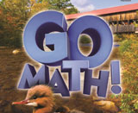
Go Math Sample Lesson 2nd Grade
Roles:
Group 1: Students in the classroom participating in the lesson
Group 2: Observers writing down what was seen in the lesson

Slide 7
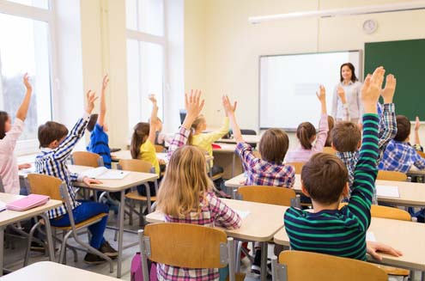
Classroom Expectations
Students will be respectful to all members of the learning community
Students will explain their thinking and the thinking of others
Students will ask questions when they do not understand
We will all work together as equal members of the learning community
Routines:
CHAMPS expectations are put in place for activities
Teacher/Student Game to reinforce CHAMPS
Playing Cards

Slide 8
Welcome Back from Recess Today’s Activities
Group/Partner Talk
C- Voice Level 1
H – Ask your partners
Raise your Hand
A- Solving Math
Problems Together
M- Getting supplies
P – Speaking and listening
Mathematicians
Class Discussion
C- Voice Level 0 listening
Voice Level 2 Speaking
H – Raise your Hand
Silent Signals
A- Learning about Math
M- None
P – Speaking and listening
Mathematicians
Independent Work
C- Voice Level 0
H –Raise your Hand
A- Solving Math
Problems
M- Teacher Permission
P – Completing math work
S- Mathematicians are learning and growing together

Slide 9
Warm Up 1:
How many ways can you make the number?
25

Slide 10
Warm Up 2:
How many ways can you make the number?
36

Slide 11
How can we use the same strategy to describe each of the numbers
25
36
42
27
48
Your own number

Slide 12
Our Question of the day: How can I break apart addends to add numbers?

Slide 13
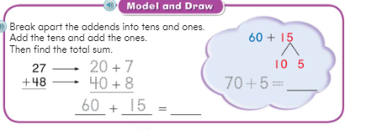
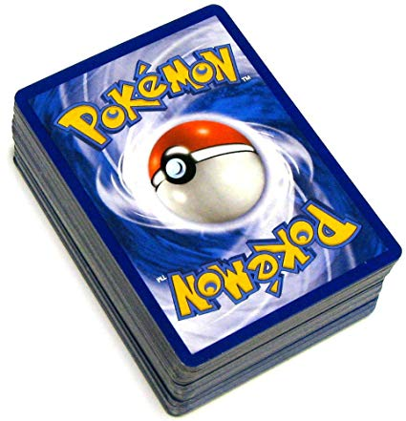
Try This problem
Jennifer has 27 Pokémon cards on her desk and Belinda has 48 Pokémon cards. If you put all of the cards into a pile, how many cards would you have altogether?

Slide 14
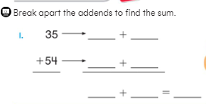
Work with a Partner to solve the problems
Break apart the addends to find the sum of 35 + 54.
35 _____ + _____
54 _____ + _____
Break apart the addends to find the sum of 43 + 29.
43 _____ + _____
29 _____ + _____

Slide 15
How did you solve the problems?

Slide 16
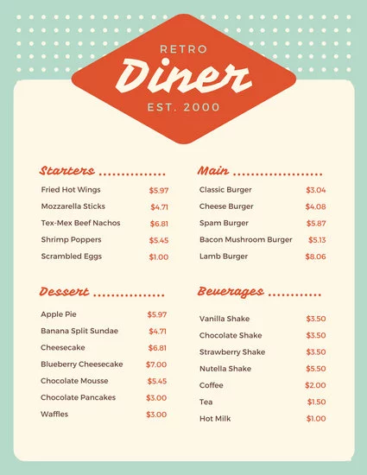
Practice Time: Practice your work (15 minutes)
Appetizer (Everyone Must Do):
Math Workbook 4, 5, 6, 7
Entrée (Choose 1 to Complete):
Work with a Partner: Math Workbook 8, 9, 10
Computer Time: Personal Math Trainer
Group Work: Work on Math with Mrs. Dozier
Dessert (Complete if you have time):
Poster: Create a word problem poster using 2 digit addition, make an answer key on the back
Enrich Worksheet
Game with a Partner: 2 Digit Shuffle

Slide 17
Exit Ticket
Julie read 19 pages in her chapter book on Monday. She read 12 pages on Tuesday. How many pages did Julie read this week?
Show your work.

